Slide 1





Slide 2
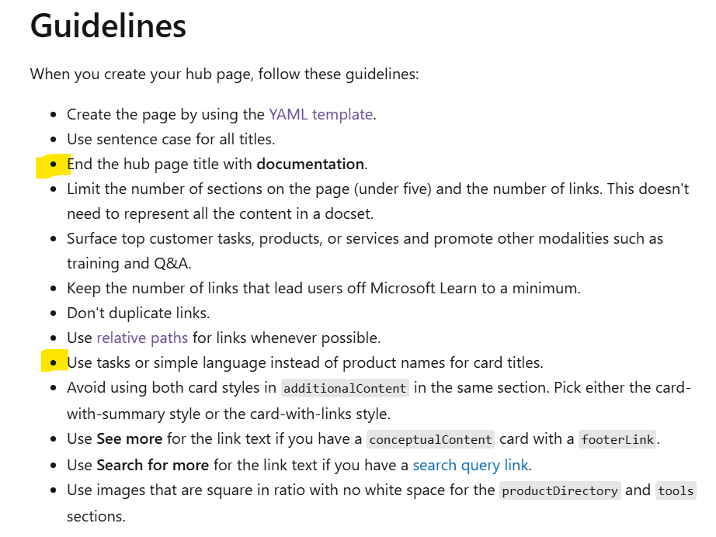
Hub page challenges
The highlighted guidelines are what we’ll need exceptions to.
We have chosen the page title “Device Partner University” which does not have documentation at the end.
We categorize by LOB and use product names like “Windows 11 Pro” and “Office 2024 Home & Business” as card titles.

Slide 3








